Slide 1
Domain : Deep Learning Technology : Python
CURRENCY CLASSIFICATION SYSTEM USING DEEP LEARNING

Slide 2
INDEX
Abstract
Introduction
Literature review
Existing Method
Drawbacks
Proposed method
Advantages
Modules
Algorithms
Hardware and Software Requirements
Architecture
UML diagrams
Results
Conclusion
Future Scope
References

Slide 3
ABSTRACT
In recent years, deep learning has become the most popular research direction. It mainly trains the dataset through neural networks. There are many different models that can be used in this research project. Throughout these models, accuracy of currency recognition can be improved. Obviously, such research methods are in line with our expectations. In this paper, we mainly use transfer learning (MobileNet) model based on deep learning as the framework, Convolutional Neural Network (CNN) model to extract the features of paper currency, so that we can more accurately classify the currency. Our main contribution is through using CNN and MobileNet, the average accuracy of currency classification is up to 99%;
KEYWORDS: Currency image dataset, CNN algorithm, MobileNet, Data Augmentation, Tensorflow.

Slide 4
INTRODUCTION
In the past, people could only authenticate money, but the observation ability of the human eyes are limited, and they are difficult to distinguish the truth or fake without the technology.
Although UV recognition technology is already in existence, with the development of counterfeiting technology, this technology is not enough to help people to identify the counterfeit currency with more advanced fraud techniques.
But now, based on image recognition, different viewpoints were shared by analyzing the currency color, design features and specific data of currency, then specific identification methods were given.

Slide 5
CONTINUATION
Currency classification methods for data argumentation through color analysis of currency images, image enhancement, rotation angle and so on were provided.
Deep learning belongs to a neural network. First, it needs a set of big data. By analyzing training dataset, the accuracy of currency classification could be continuously improved and our expectations for experimental results could be achieved.
Convolutional neural network (CNN) plays a vital role in the recognition process and can improve the accuracy of the overall training through using CNN model. We use CNN as a feature extractor under the framework of Transfer learning (MobileNet) model.

Slide 6
LITERATURE REVIEW
S. NO | Journal Type with year | Authors | Title | Outcomes
1 | July 2018 International Journal of Digital Crime and Forensics | DeRen, Y., Nguyen, M., Yan, Wng, L., & Yu, D. | Real-Time Recognition of Series Seven New Zealand Banknotes | It has demonstrated excellent recognition results in an indoor environment and is comparatively less time-consuming that makes it suitable for real-time applications
2. | Research paper 2017 | Shen Huijun | The State-of-the-Art Technology of Currency Identification: A Comparative Study | Our contributions are to find and implement various algorithms from the existing literatures and choose the best approaches for use.

Slide 7
CONTINUATION
3. | IEEE Transactions 2016 | Hoo-Chang, S., Roth, H. R., Gao, M., Lu, L., Xu, Z., Nogues, I., | Deep convolutional neural networks for computer-aided detection | We exploit three important, but previously understudied factors of employing deep convolutional neural networks to computer-aided detection problems.
4. | conference 2016 | Liu, W., Anguelov, D., Erhan, D., Szegedy, C., Reed, S., Fu, C. Y., & Berg, A. C. | SSD: Single shot multibox detector. | Detecting objects in images using a single deep neural network.
5. | Journal 2016 | Najafabadi, M. M., Villanustre, F., Khoshgoftaar, T. M., Seliya, N., Wald, R., & Muharemagic, E. | Deep learning applications and challenges in big data analytics. | We explore how Deep Learning can be utilized for addressing some important problems in Big Data Analytics, including extracting complex patterns from massive volumes of data

Slide 8
EXISTING METHOD
In the existing system, all the work is done manually. The recognition of the currency is done by observing the money visually by human. Where there are no machines existed previously to recognise or classify the currency.

Slide 9
DISADVANTAGES
Difficult to navigate.
Time taking process.
Difficult to manage the data.

Slide 10
PROPOSED SYSTEM
The Proposed currency system is mainly uses one of the Deep learning techniques CNN based transfer learning (MobileNet) model. This transfer learning method is used to extract the features from the conceder dataset, once after the feature collection the saved model is used to classify and predict the currency types more accurately.

Slide 11
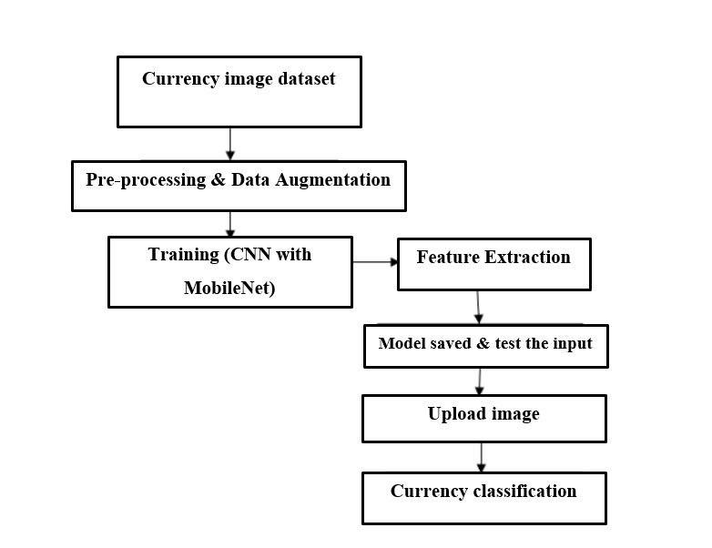
BLOCK DIAGRAM

Slide 12
ADVANTAGES
Simple to navigate.
Reducing the time.
Easy to manage the data.

Slide 13
MODULES
Create Dataset:
We are collecting the dataset through internet browsing.
The size of overall dataset is 136 MB. From which we have are splitting the data into (train, test), where the train dataset size is 100 MB and test size is 35.6 MB.
Training:- We are using the pre-processed training dataset to train our model using CNN algorithm.
CNN algorithm consists of 4 layers: Input layer, Convolution Layer, pooling layer, Flatten layer and dense layer.
In input layer we consider images as input.

Slide 14
MODULES
Here we considering the input layer is the pre-trained mobile net.
In Convolution layer, we convert image into matric format. Here matrix size is 1024 X 1024 (rows X columns).
In the pooling layer the numerical values will be stored. To change the numerical data to binary data, we use machine learning algorithm named Softmax (supervised learning algorithm). In Softmax layer we will convert the numerical data to binary.
In flatten layer and dense the classes of total dataset (10 types) is stored which will be in the binary data format.

Slide 15
MODULES
We use fit_generator method for saving the data in the form of .h5. Here model is a format for storing the binary data.
Testing:
Upload the currency image that which to be predicted. Once after the classification the predicted output is displayed.

Slide 16
ALGORITHMS
CNN(Convolutional Neural Network):
In deep learning, a convolutional neural network (CNN, or ConvNet) is a class of deep neural networks, most commonly applied to analyzing visual imagery.
A convolutional neural network consists of an input layer, hidden layers and an output layer. In any feed-forward neural network, any middle layers are called hidden because their inputs and outputs are masked by the activation function and final convolution. In a convolutional neural network, the hidden layers include layers that perform convolutions. Typically this includes a layer that does multiplication or other dot product, and its activation function is commonly ReLU. This is followed by other convolution layers such as pooling layers, fully connected layers and normalization layers.

Slide 17
HARDWARE AND SOFTWARE REQUIREMENTS
H/W Configuration:
Processor - I3/Intel Processor
Hard Disk - 160GB
RAM - 8Gb

Slide 18
S/W Configuration:
Operating System : Windows 7/8/10
Front End : HTML, CSS
Scripts : JavaScript.
Technology : Python 3.9+.
IDE : Pycharm

Slide 19
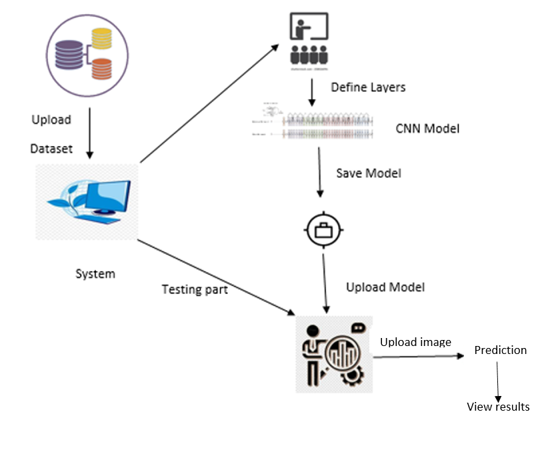
ARCHITECTURE

Slide 20
USE CASE DIAGRAM
A use case diagram in the Unified Modeling Language (UML) is a type of behavioral diagram defined by and created from a Use-case analysis. Its purpose is to present a graphical overview of the functionality provided by a system in terms of actors, their goals (represented as use cases), and any dependencies between those use cases. The main purpose of a use case diagram is to show what system functions are performed for which actor. Roles of the actors in the system can be depicted.

Slide 21
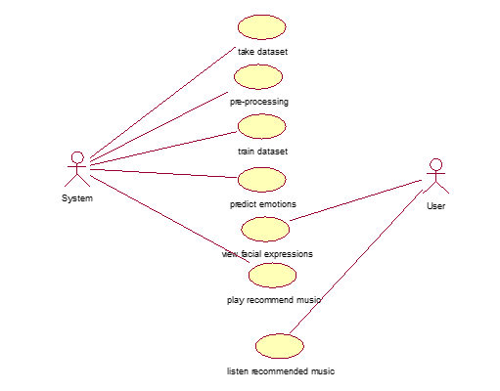
USE CASE DIAGRAM

Slide 22
CLASS DIAGRAM
In software engineering, a class diagram in the Unified Modeling Language (UML) is a type of static structure diagram that describes the structure of a system by showing the system's classes, their attributes, operations (or methods), and the relationships among the classes. It explains which class contains information.

Slide 23
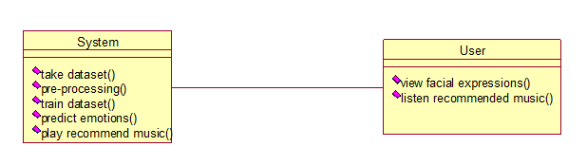
CLASS DIAGRAM

Slide 24
SEQUENCE DIAGRAM
A sequence diagram in Unified Modeling Language (UML) is a kind of interaction diagram that shows how processes operate with one another and in what order. It is a construct of a Message Sequence Chart. Sequence diagrams are sometimes called event diagrams, event scenarios, and timing diagrams.

Slide 25
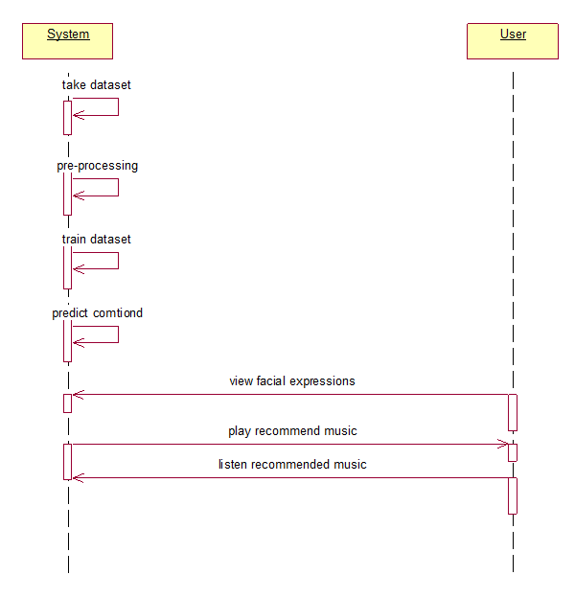
SEQUENCE DIAGRAM

Slide 26
COLLABORATION DIAGRAM
In collaboration diagram the method call sequence is indicated by some numbering technique as shown below. The number indicates how the methods are called one after another. We have taken the same order management system to describe the collaboration diagram. The method calls are similar to that of a sequence diagram. But the difference is that the sequence diagram does not describe the object organization where as the collaboration diagram shows the object organization.

Slide 27
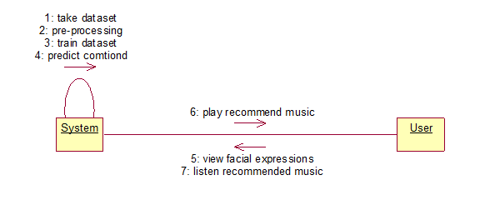
Collaboration Diagram

Slide 28
DEPLOYMENT DIAGRAM
Deployment diagram represents the deployment view of a system. It is related to the component diagram. Because the components are deployed using the deployment diagrams. A deployment diagram consists of nodes. Nodes are nothing but physical hardware used to deploy the application.

Slide 29
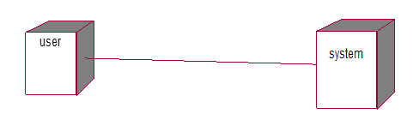
DEPLOYMENT DIAGRAM

Slide 30
ACTIVITY DIAGRAM
Activity diagrams are graphical representations of workflows of stepwise activities and actions with support for choice, iteration and concurrency.
In the Unified Modeling Language, activity diagrams can be used to describe the business and operational step-by-step workflows of components in a system.
An activity diagram shows the overall flow of control.

Slide 31
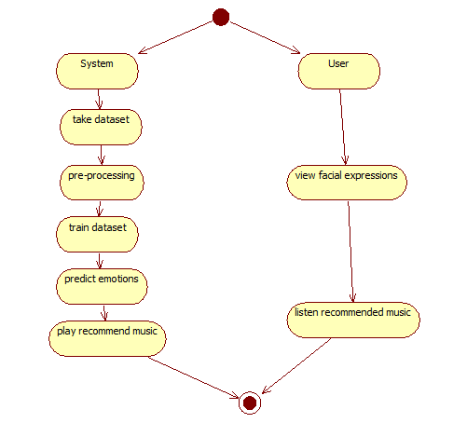
ACTIVITY DIAGRAM

Slide 32
COMPONENT DIAGRAM
A component diagram, also known as a UML component diagram, describes the organization and wiring of the physical components in a system.
Component diagrams are often drawn to help model implementation details and double-check that every aspect of the system's required functions is covered by planned development.

Slide 33
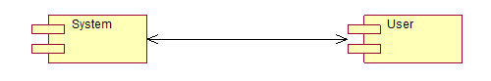
COMPONENT DIAGRAM

Slide 34
ER DIAGRAM
An Entity–relationship model (ER model) describes the structure of a database with the help of a diagram, which is known as Entity Relationship Diagram (ER Diagram).
An ER diagram shows the relationship among entity sets. An entity set is a group of similar entities and these entities can have attributes.
In terms of DBMS, an entity is a table or attribute of a table in database, so by showing relationship among tables and their attributes, ER diagram shows the complete logical structure of a database.

Slide 35
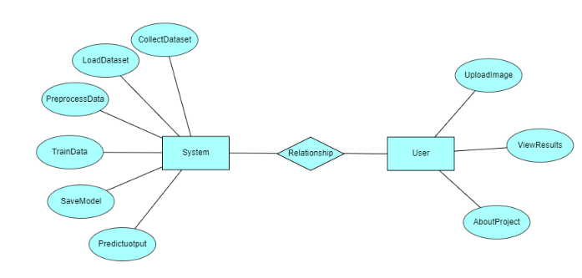

Slide 36
DF DIAGRAM
A Data Flow Diagram (DFD) is a traditional way to visualize the information flows within a system.
A neat and clear DFD can depict a good amount of the system requirements graphically. It can be manual, automated, or a combination of both.
It shows how information enters and leaves the system, what changes the information and where information is stored.
The purpose of a DFD is to show the scope and boundaries of a system as a whole.
It may be used as a communications tool between a systems analyst and any person who plays a part in the system that acts as the starting point for redesigning a system.

Slide 37
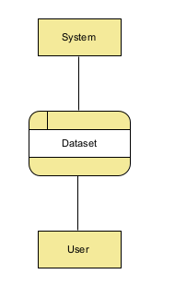
Context Level diagram

Slide 38
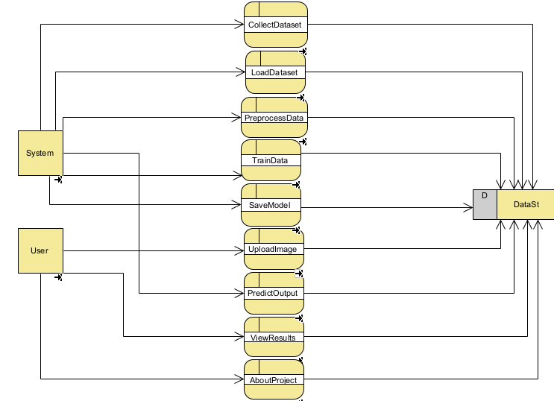
Level-1 Diagram

Slide 39
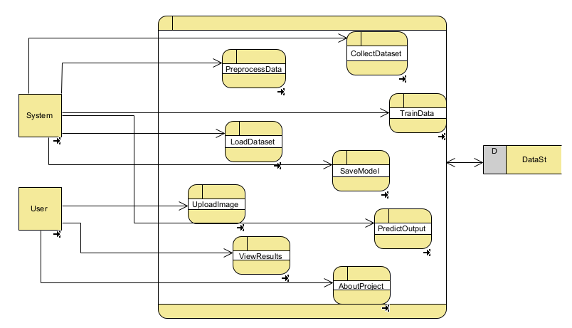
Level-2 Diagram

Slide 40
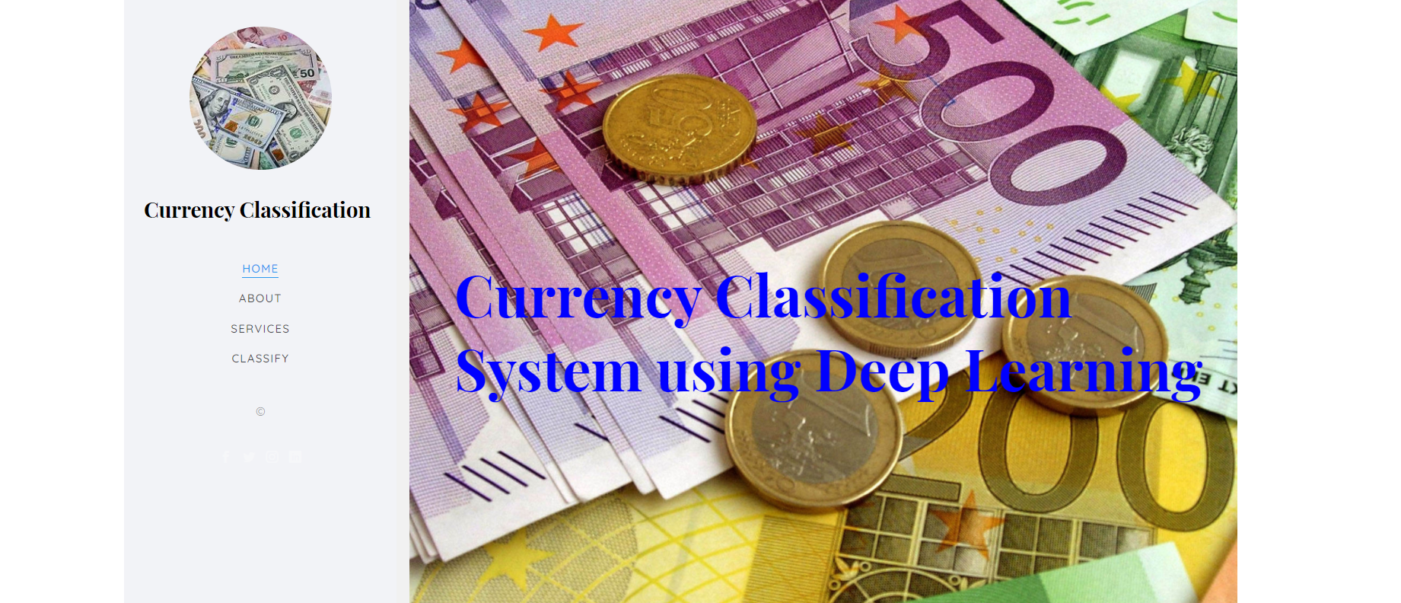
RESULTS
Home: In this page will display the modules of a project
Fig1: Home

Slide 41

About project page:
Here display the main theme of project.

Slide 42

Services page:

Slide 43
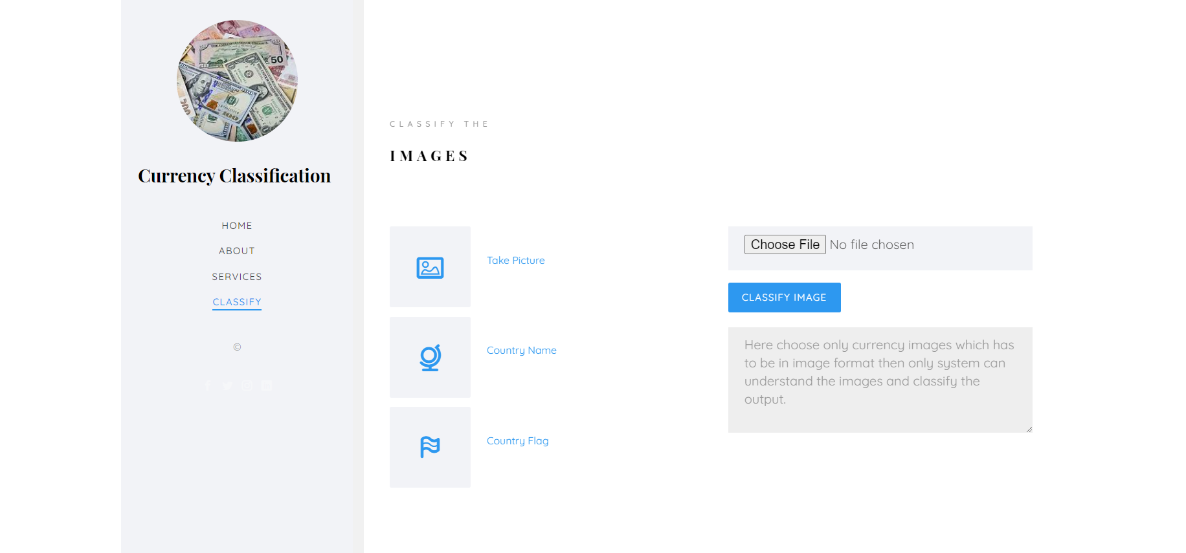
Image Upload page:
Here image files can be uploaded to classify whether the image which class it is.

Slide 44
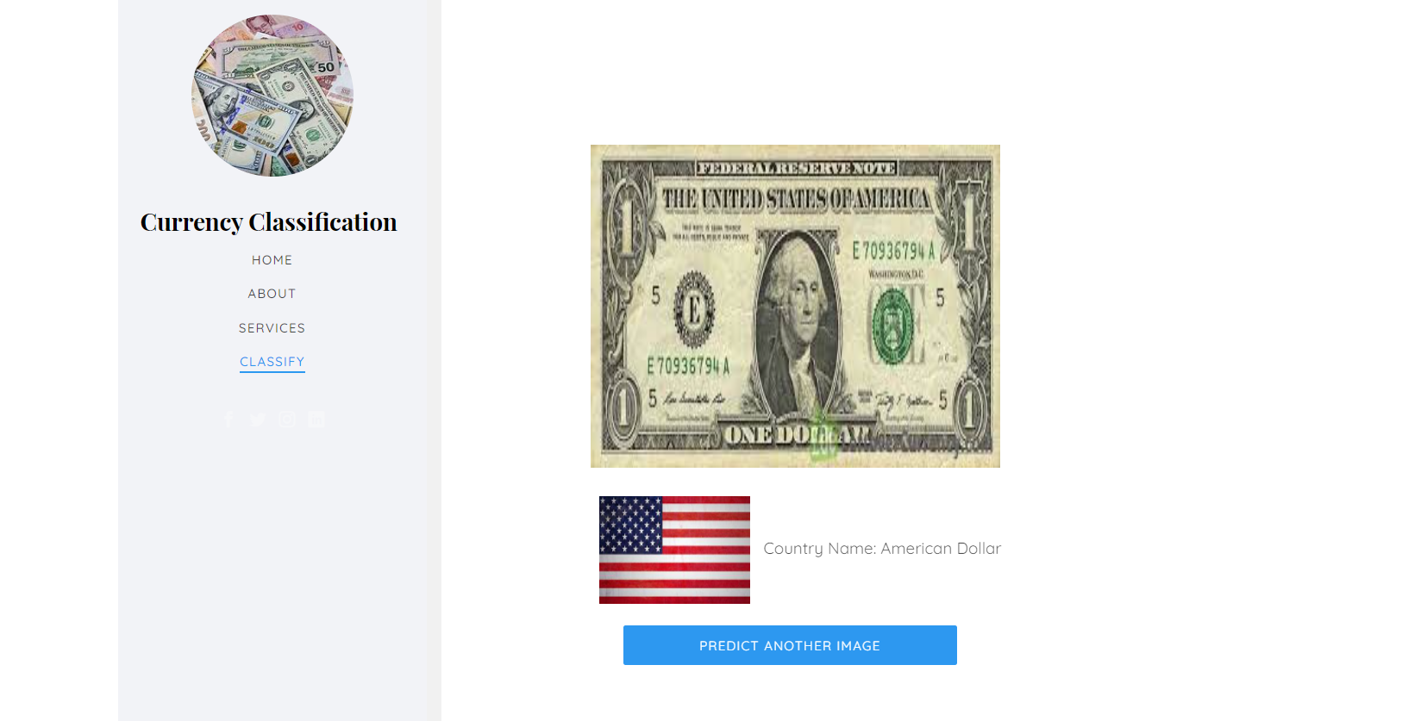
View uploaded Image information:
Here model classify the image is “American Dollar”.

Slide 45
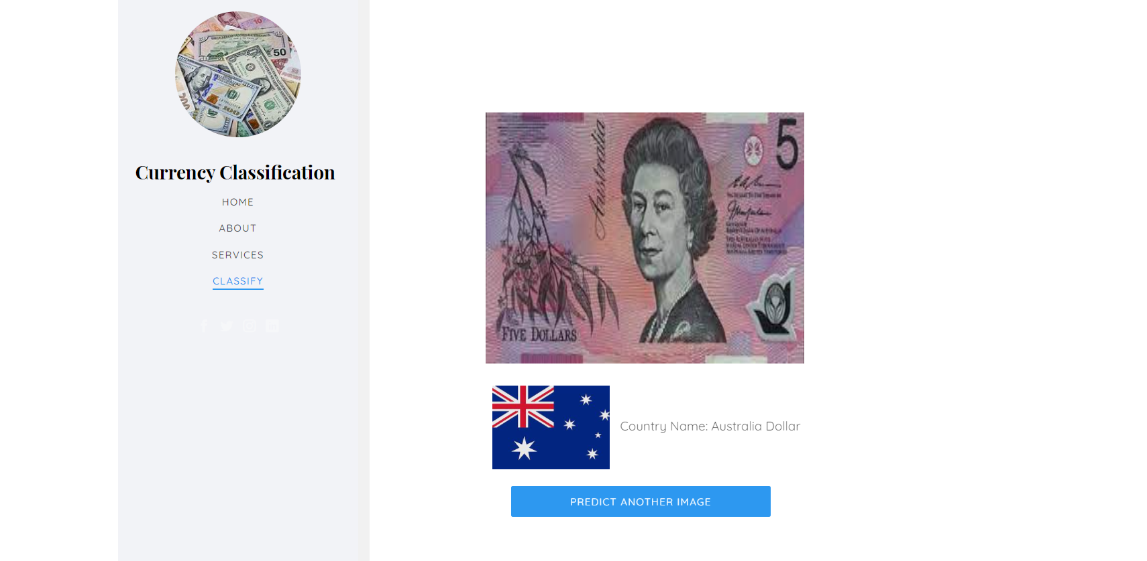
Here model classify the image is “Australia Dollar”.

Slide 46
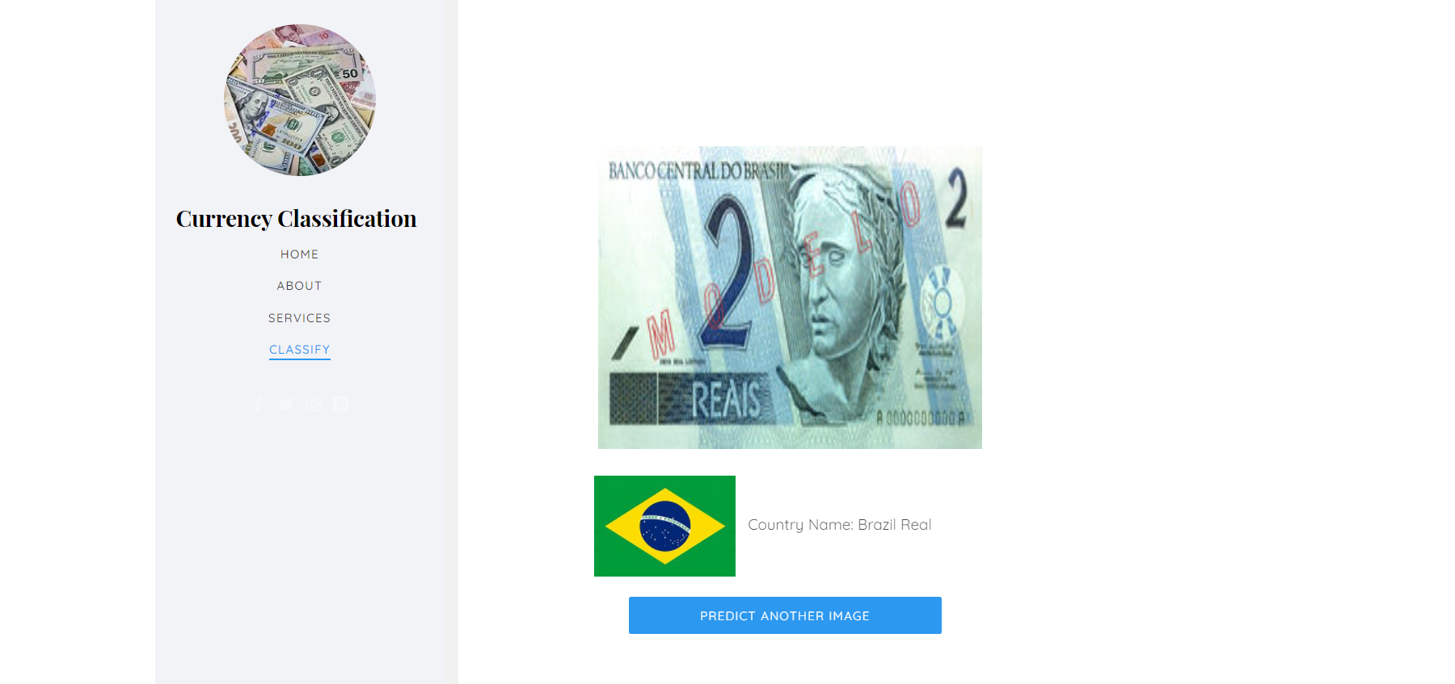
Here Model Classify The Image Is “Brazil Real”.

Slide 47

Here Model Classify The Image Is “China Yuan”.

Slide 48
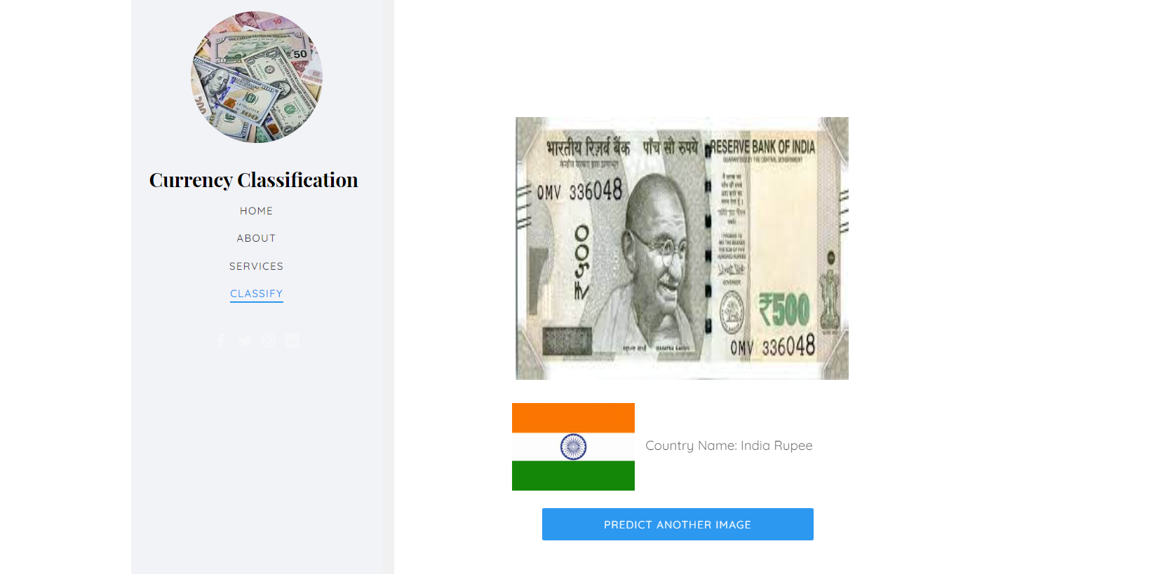
Here model classify the image is “India Rupee”.

Slide 49
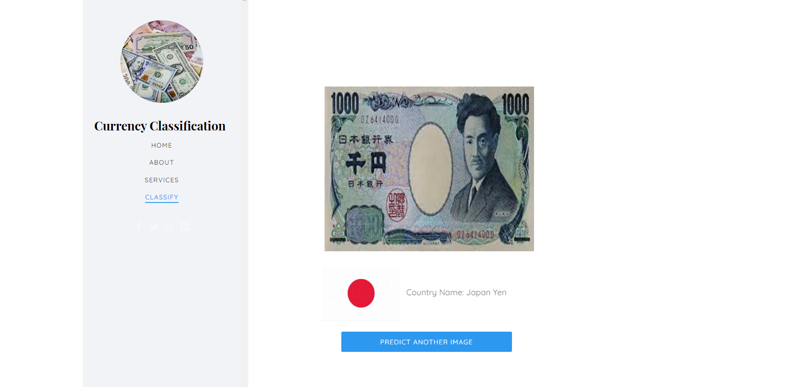
Here model classify the image is “Japan Yen”.

Slide 50
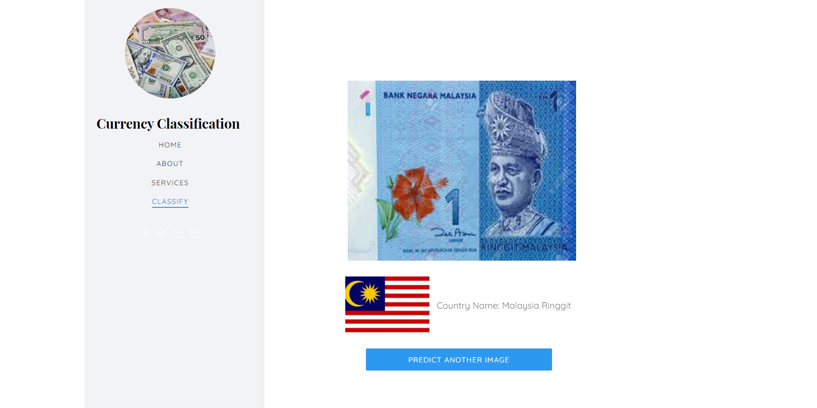
Here model classify the image is “Malaysia Ringgit”.

Slide 51

Here model classify the image is “Philippines Peso”.

Slide 52
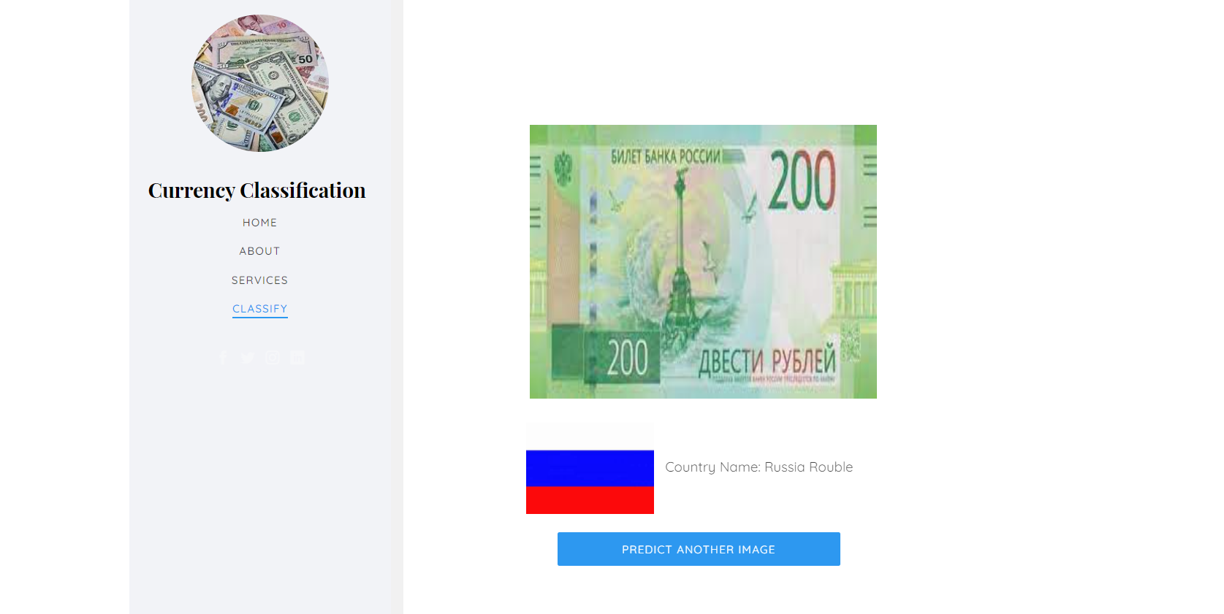
Here model classify the image is “Russia Rouble”.

Slide 53
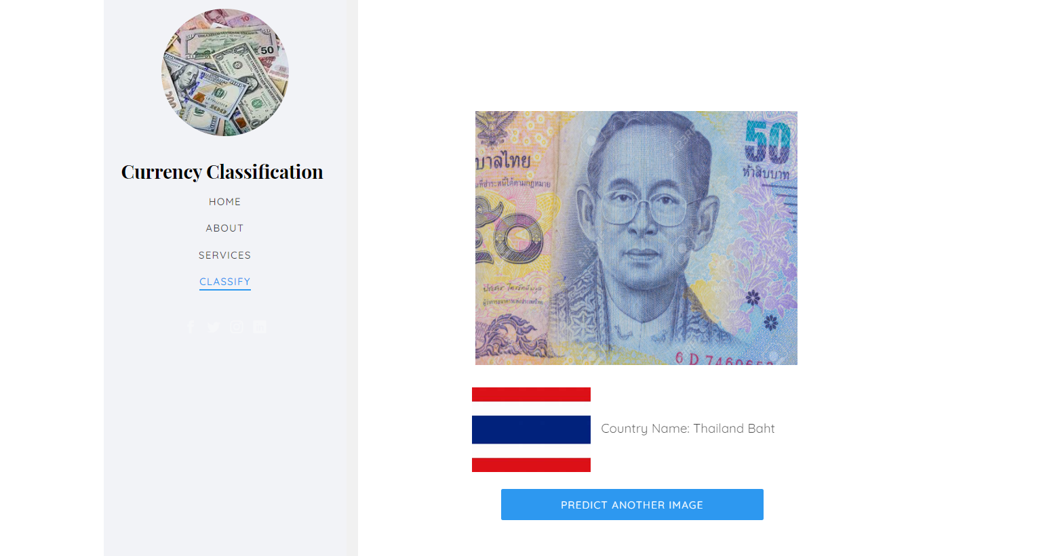
Here model classify the image is “Thailand Baht”.

Slide 54
CONCLUSION
The main purpose of this paper is to carry out currency detection. In fact, it includes the denomination of currency. We trained the CNN with MobileNet model, tested different currency images. We have also received satisfactory results. We chose to create a CNN model as a feature extractor. After feature extraction for our currency recognition training. Finally, the trained model could reach 99% accuracy, which shows that our dataset has been fully trained. From the loss function, we see that our model does not have over fitting during the training process. The final research results are satisfactory, the accuracy is very high. The accuracy of the recognition will decrease slightly, but because the dataset is fully trained, the experiments of currency recognition can still be conducted well.

Slide 55
FUTURE WORK
In future, we should consider training the model on large amount of data to have better accuracy and predictability. This process can help the machines to recognize the more number of currency’s.

Slide 56
References
[1] Ren, Y., Nguyen, M., Yan, W. (2018) Real-Time Recognition of Series Seven New Zealand Banknotes. IJDCF 10(3): 50-65
[2] Wang, G., Wu, X., Yan, Q. (2017) The State-of-theArt Technology of Currency Identification: A Comparative Study. IJDCF 9(3): 58-72
[3] Hoo-Chang, S., Roth, H. R., Gao, M., Lu, L., Xu, Z., Nogues, I., ... & Summers, R. M. (2016) Deep convolutional neural networks for computer-aided detection: CNN architectures, dataset characteristics and transfer learning. IEEE Transactions on Medical Imaging, 35(5), 1285.

Slide 57
[5] Liu, W., Anguelov, D., Erhan, D., Szegedy, C., Reed, S., Fu, C. Y., & Berg, A. C. (2016). SSD: Single shot multibox detector. In European conference on computer vision (pp. 21-37).
[5] Najafabadi, M. M., Villanustre, F., Khoshgoftaar, T. M., Seliya, N., Wald, R., & Muharemagic, E. (2015) Deep learning applications and challenges in big data analytics. Journal of Big Data, 2(1), 1.

Slide 58
THANK YOU

